Slide 1

ABOUT US
SECTORS
OUR ACTIVITIES
OUR TEAM
CONTACTS
About Us
Health Pacific Partners provides you a complete advisory for your mergers & acquisitions and strategic partnerships in Asia
Hyperion advises clients on mergers & acquisitions (M&A) and strategic partnerships in Asia and other regions, serving clients in a professional and transparent way.
​
Completely dedicated to life sciences, we have a thorough expertise and knowledge in pharmaceutical and animal health business.
​
Based in Ho-Chi-Minh-City, we cover all countries in Asia and connect our customers to other regions across the world via an extensive network.

Slide 2
OUR ADVANTAGES
Professionalism
we are a team of experts of the Life Science industry, with international background and significant credentials in M&A and Licensing
Reliable
we maintain consistently high performance when we deliver
Management of projects in Emerging Markets
we manage licensing/M&A deals in complex Emerging countries
Decentralized business model
our multicultural team is split into different countries allowing us to manage more efficiently the mandates and identify on field local opportunities

Slide 3
OUR VALUES
Integrity
We act with integrity and total professionalism, as well as foster an open company culture
Value-adding
We constantly strive to add value to our clients’ business
Clients first
We always put our clients’ interests first
Result-oriented
We do what it takes to get the results for our clients, and are creative and innovative in solving problems

Slide 4

ABOUT US
SECTORS
OUR ACTIVITIES
OUR TEAM
CONTACTS
Our Sectors
Health Pacific Partners is 100% dedicated to human and animal health sectors

Slide 5






HEALTH PACIFIC PARTNERS
A network of 450 companies dedicated to animal health
Adjusted targeting based on the type of company you search for…
FEEDS
GENERICS
PET CARE
BIOTECHS
BIOLOGICS

Slide 6
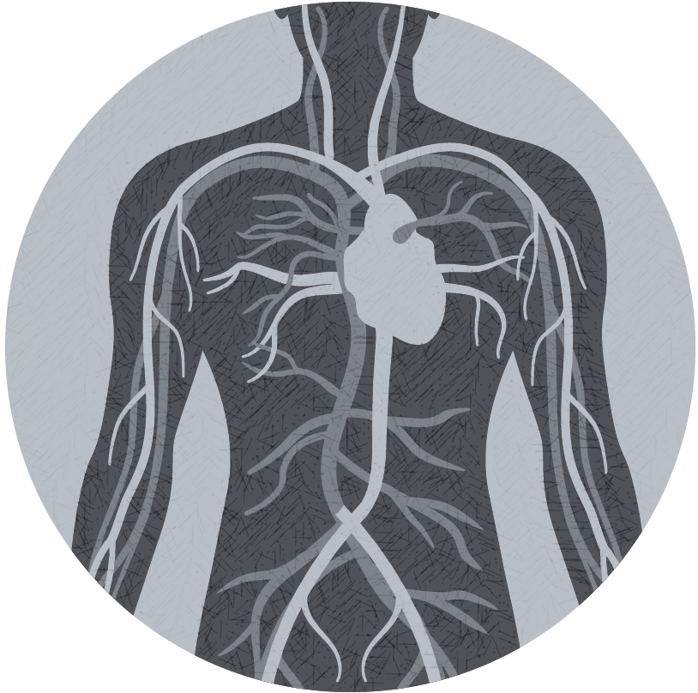
HEALTH PACIFIC PARTNERS
can offer you a large network to address your needs
2 800 companies in human health
Our capabilities in
MATURE MARKETS
Our capabilities in EMERGING MARKETS
PRESCRIPTION DRUGS
OTC/CONSUMER HEALTH
ORPHAN DRUGS
MEDICAL DEVICES

Slide 7

OUR ACTIVITIES
ABOUT US
SECTORS
OUR ACTIVITIES
OUR TEAM
CONTACTS
Market screening
Via our strong network and deep knowledge of Asia, we are help to identify tailor-made opportunities for our customers.
Transaction Services
We assist our customers in buying and/or selling assets. From the assessment until the closing of the transaction we help our customers at each stage of the process.
Strategic Partnerships
We assist you for your distribution and licensing deals in each territory you may consider. From the selection of opportunities to the agreement, we are pleased to provide you the best service.

Slide 8

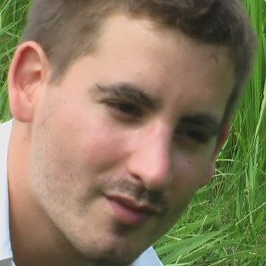
OUR TEAM
ABOUT US
SECTORS
OUR ACTIVITIES
OUR TEAM
CONTACTS
Guillaume CLAYEUX is one of the founders of Health Pacific Partners, a M&A and licensing advisory company dedicated to human and animal health.
Background: More than 15 years of experience in the pharmaceutical industry (Sanofi, Urgo, Virbac) in various sectors: OTC, Biotech, Biologicals, Generics…
Network: More than 1 000 contacts in both Human and Animal health sector thanks to a strong experience in Business Development and Licensing in Europe and Asia.
Education: Master in Economics at the IEP of Aix-en-Provence – Master in Pharmaceutical Management at ESCP Europe Business School of Paris – Master in Public Affairs at the Catholic Institute of Paris
Core competencies: Distribution – Acquisitions – Licensing in & out

Slide 9

Contact Us Find below more about our company and our services
ABOUT US
SECTORS
OUR ACTIVITIES
OUR TEAM
CONTACTS

